Slide 1

Impact of environmental triggers and seasonality on the epithelium
CN-142722; date of preparation: Dec 2024. © 2025 AstraZeneca. All Rights Reserved. This information is intended for healthcare professionals only. EpiCentral is sponsored and developed by Amgen and AstraZeneca.

Slide 2
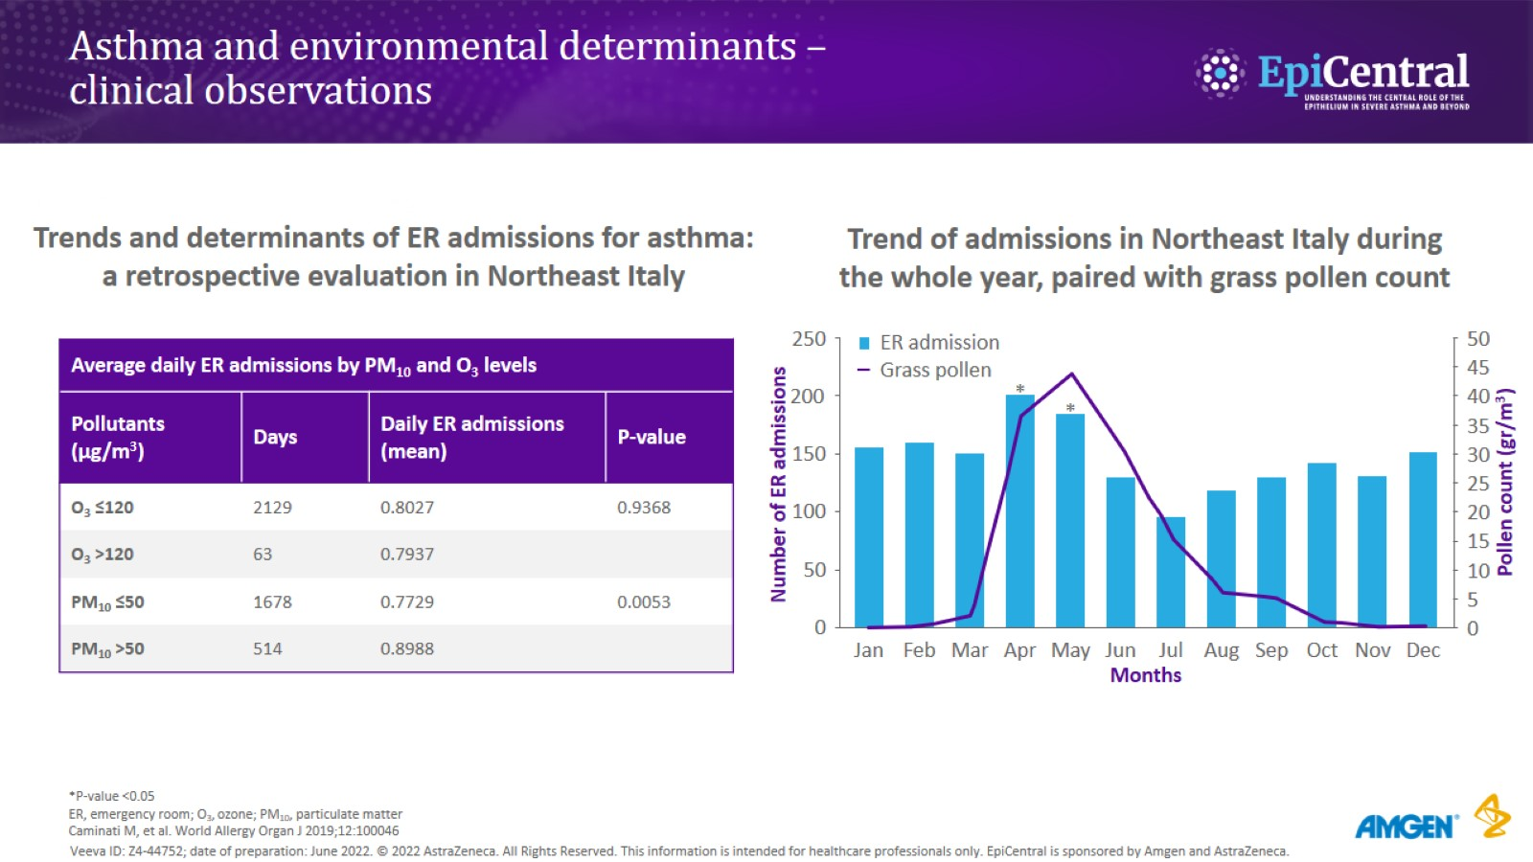
Asthma and environmental determinants – clinical observations
CN-142722; date of preparation: Dec 2024. © 2025 AstraZeneca. All Rights Reserved. This information is intended for healthcare professionals only. EpiCentral is sponsored and developed by Amgen and AstraZeneca.

Slide 3
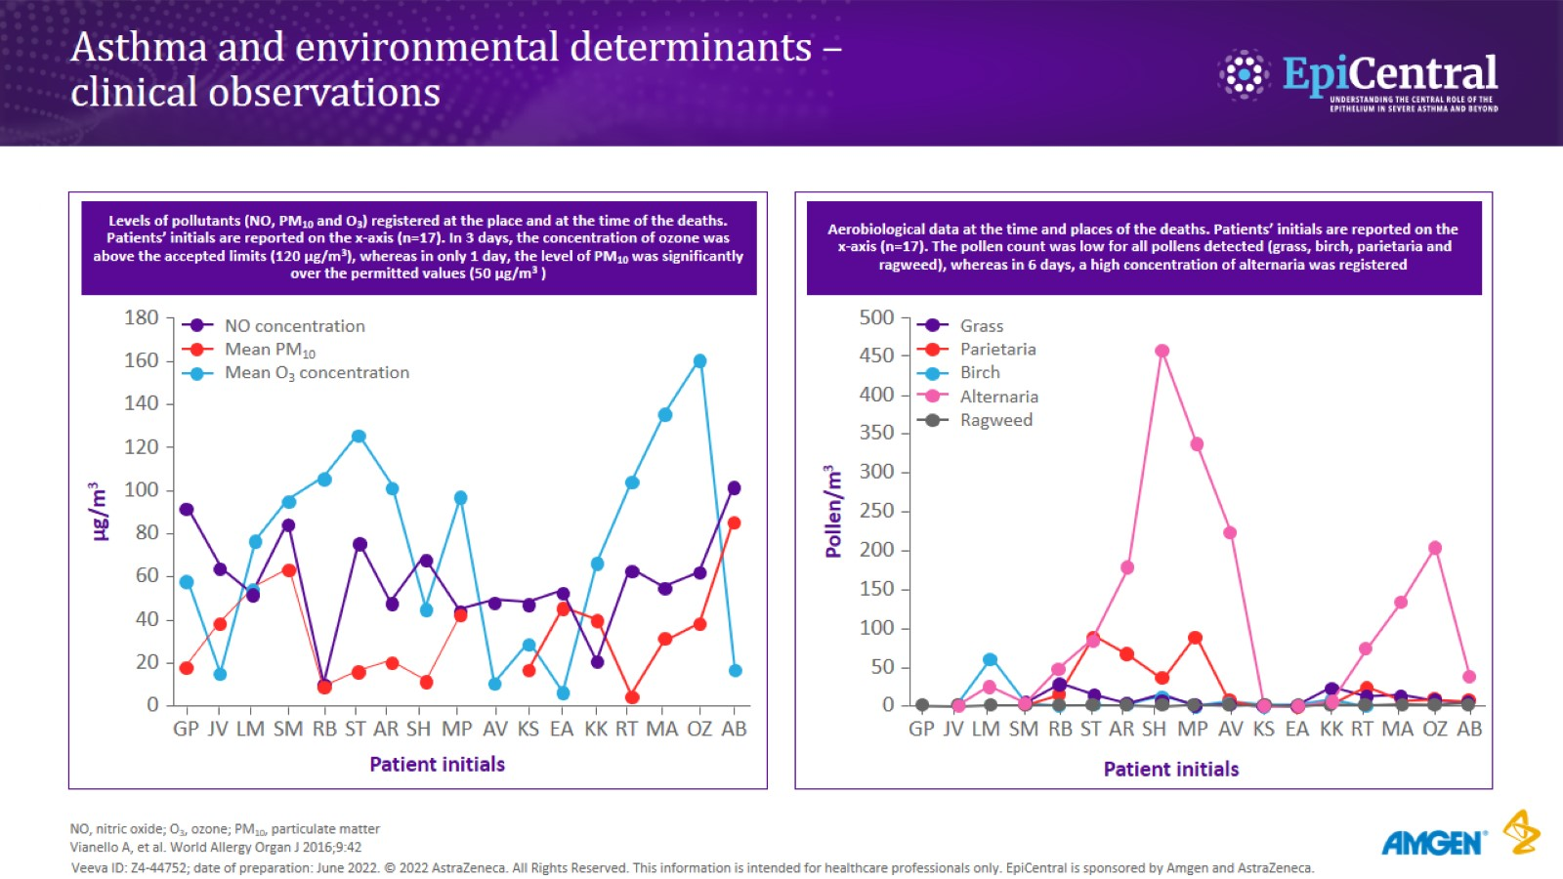
Asthma and environmental determinants – clinical observations
CN-142722; date of preparation: Dec 2024. © 2025 AstraZeneca. All Rights Reserved. This information is intended for healthcare professionals only. EpiCentral is sponsored and developed by Amgen and AstraZeneca.

Slide 4
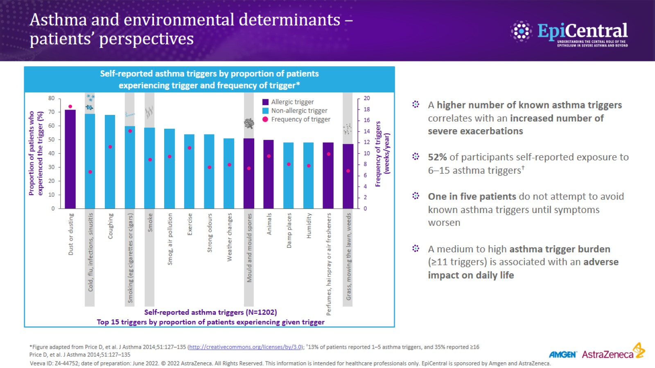
Asthma and environmental determinants – patients’ perspectives
CN-142722; date of preparation: Dec 2024. © 2025 AstraZeneca. All Rights Reserved. This information is intended for healthcare professionals only. EpiCentral is sponsored and developed by Amgen and AstraZeneca.

Slide 5
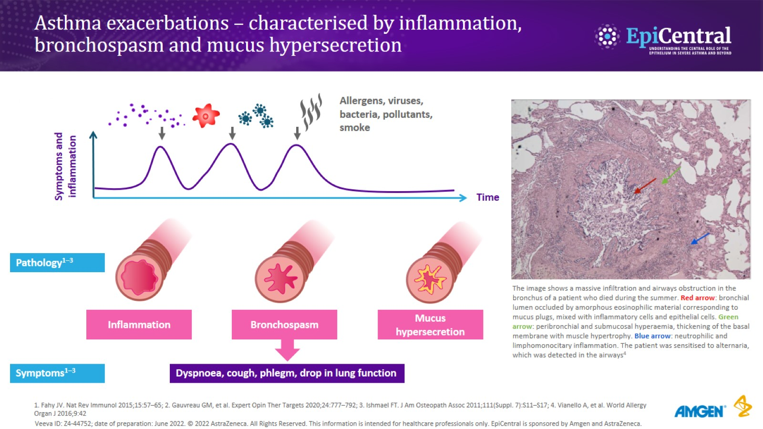
Asthma exacerbations – characterised by inflammation, bronchospasm and mucus hypersecretion
CN-142722; date of preparation: Dec 2024. © 2025 AstraZeneca. All Rights Reserved. This information is intended for healthcare professionals only. EpiCentral is sponsored and developed by Amgen and AstraZeneca.

Slide 6
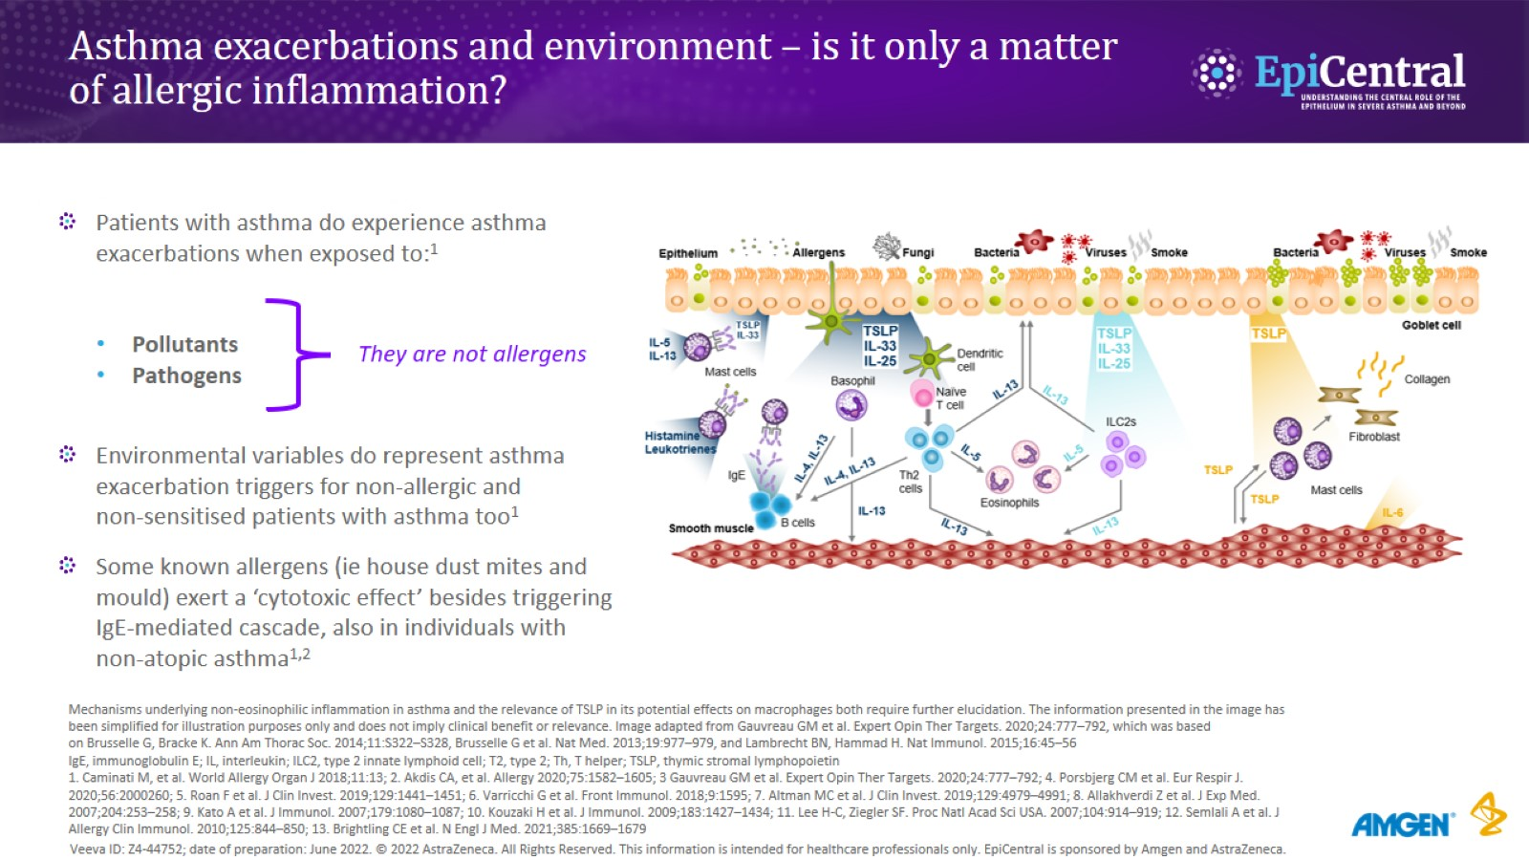
Asthma exacerbations and environment – is it only a matter of allergic inflammation?
CN-142722; date of preparation: Dec 2024. © 2025 AstraZeneca. All Rights Reserved. This information is intended for healthcare professionals only. EpiCentral is sponsored and developed by Amgen and AstraZeneca.

Slide 7
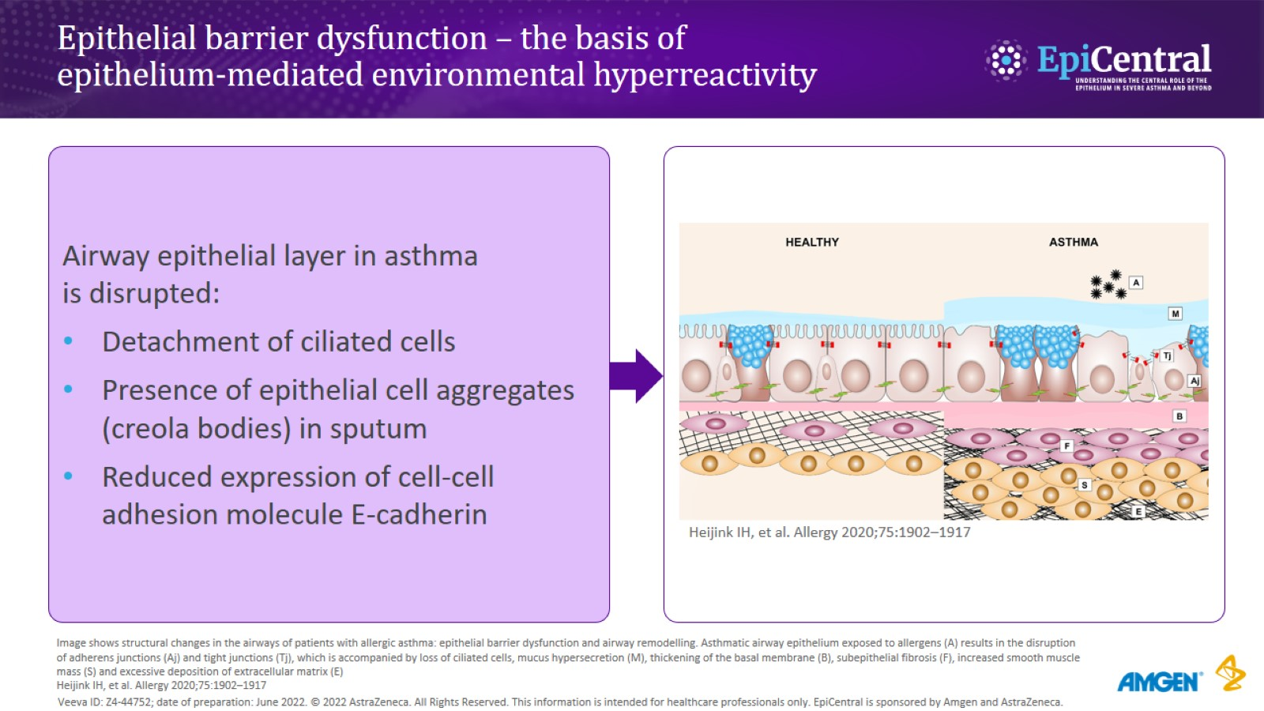
Epithelial barrier dysfunction – the basis of epithelium-mediated environmental hyperreactivity
CN-142722; date of preparation: Dec 2024. © 2025 AstraZeneca. All Rights Reserved. This information is intended for healthcare professionals only. EpiCentral is sponsored and developed by Amgen and AstraZeneca.

Slide 8
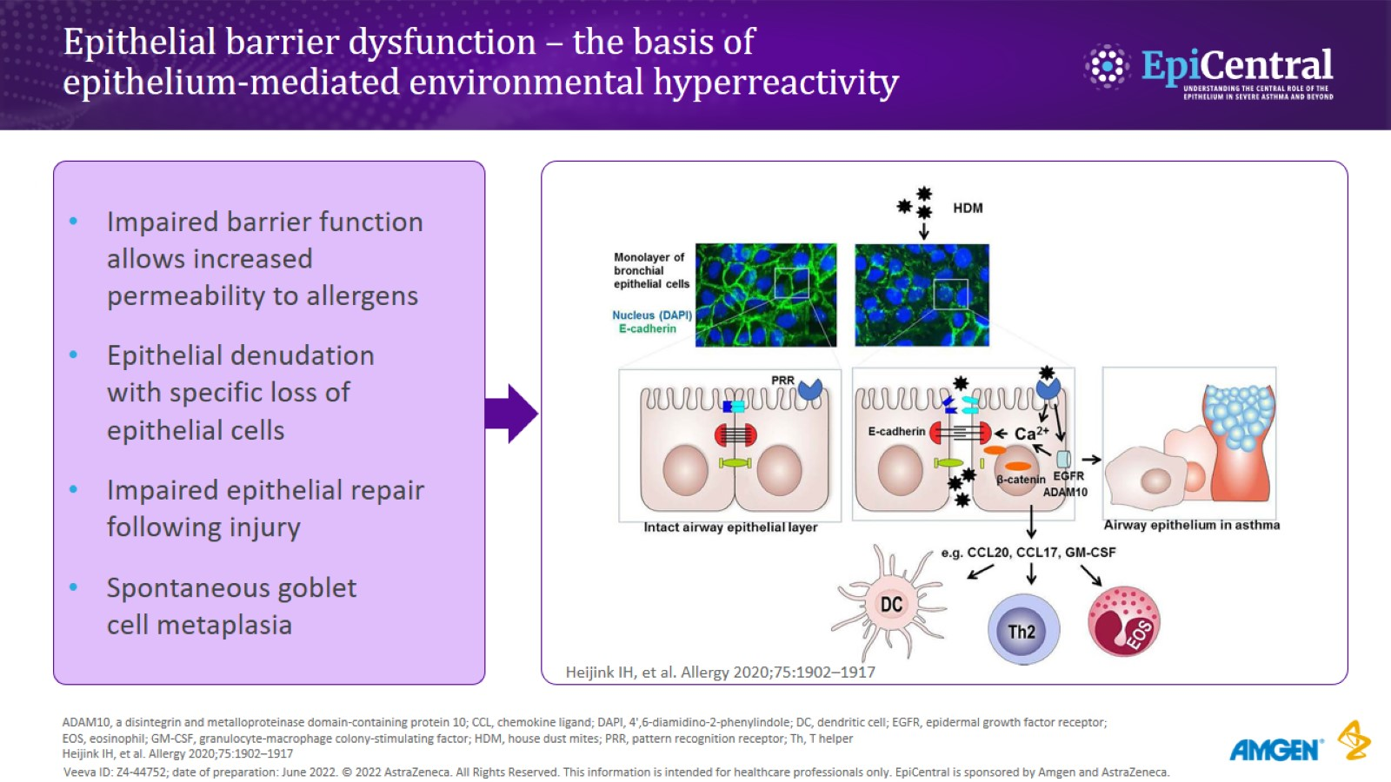
Epithelial barrier dysfunction – the basis of epithelium-mediated environmental hyperreactivity
CN-142722; date of preparation: Dec 2024. © 2025 AstraZeneca. All Rights Reserved. This information is intended for healthcare professionals only. EpiCentral is sponsored and developed by Amgen and AstraZeneca.

Slide 9
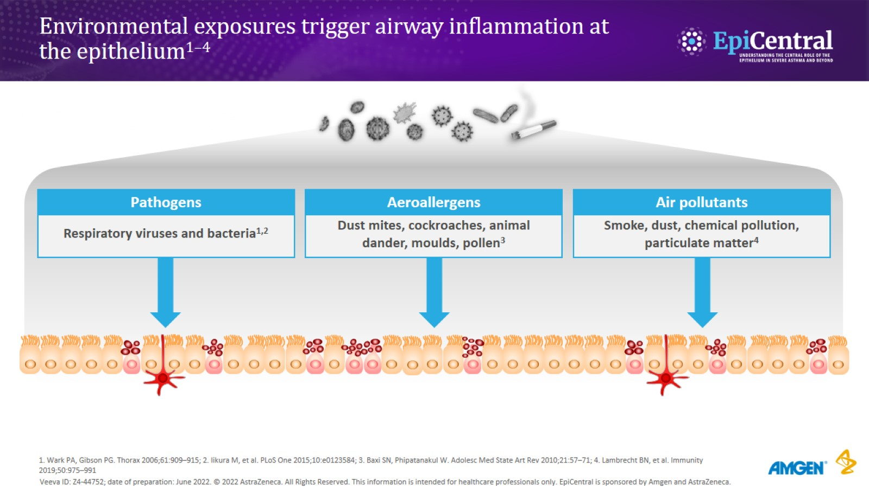
Environmental exposures trigger airway inflammation at the epithelium^{1–4}
CN-142722; date of preparation: Dec 2024. © 2025 AstraZeneca. All Rights Reserved. This information is intended for healthcare professionals only. EpiCentral is sponsored and developed by Amgen and AstraZeneca.

Slide 10
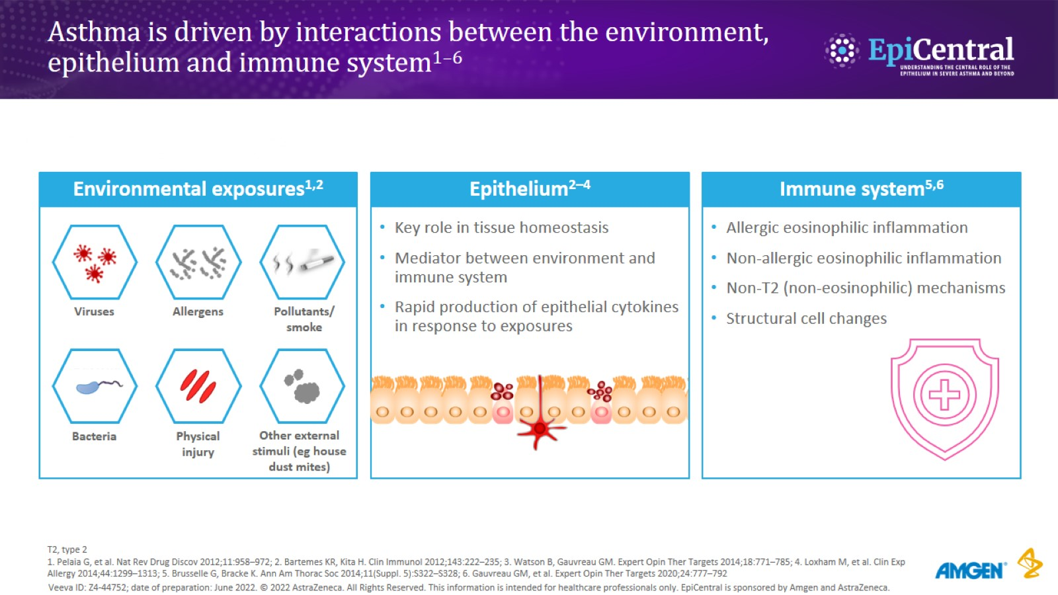
Asthma is driven by interactions between the environment, epithelium and immune system^{1–6}
CN-142722; date of preparation: Dec 2024. © 2025 AstraZeneca. All Rights Reserved. This information is intended for healthcare professionals only. EpiCentral is sponsored and developed by Amgen and AstraZeneca.

Slide 11
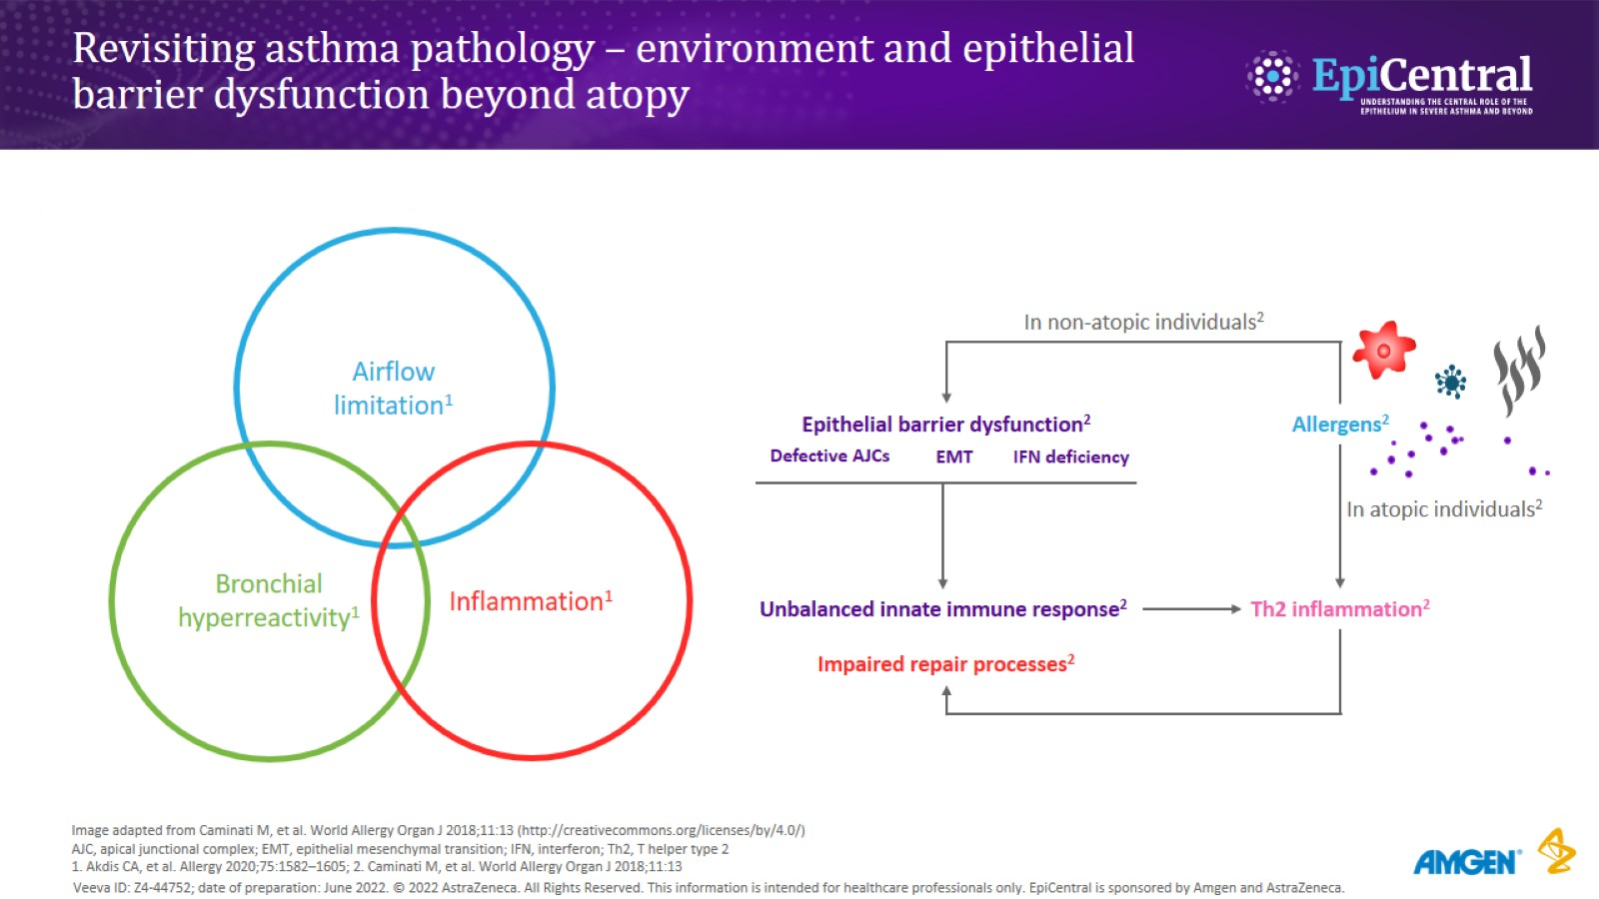
Revisiting asthma pathology – environment and epithelial barrier dysfunction beyond atopy
CN-142722; date of preparation: Dec 2024. © 2025 AstraZeneca. All Rights Reserved. This information is intended for healthcare professionals only. EpiCentral is sponsored and developed by Amgen and AstraZeneca.

Slide 12
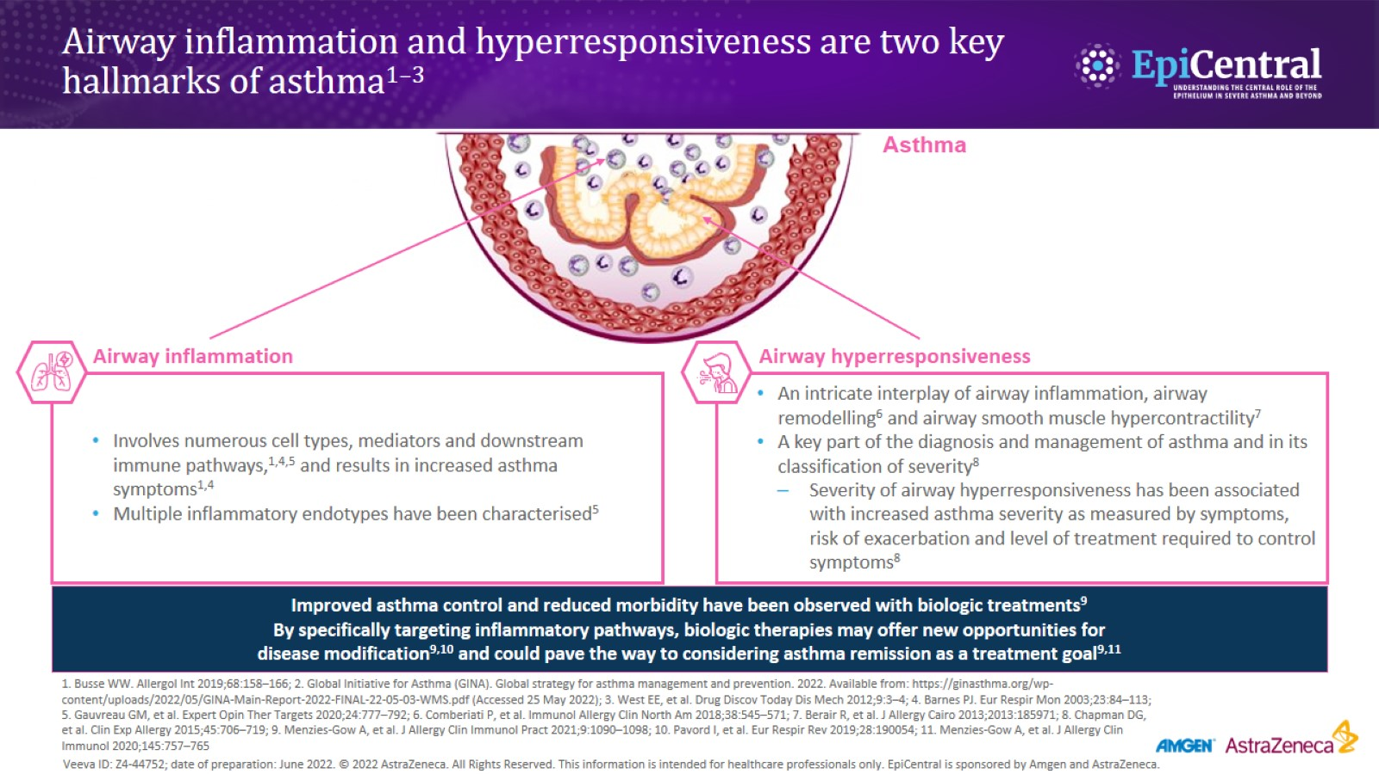
Airway inflammation and hyperresponsiveness are two key hallmarks of asthma^{1–3}
CN-142722; date of preparation: Dec 2024. © 2025 AstraZeneca. All Rights Reserved. This information is intended for healthcare professionals only. EpiCentral is sponsored and developed by Amgen and AstraZeneca.

Slide 13
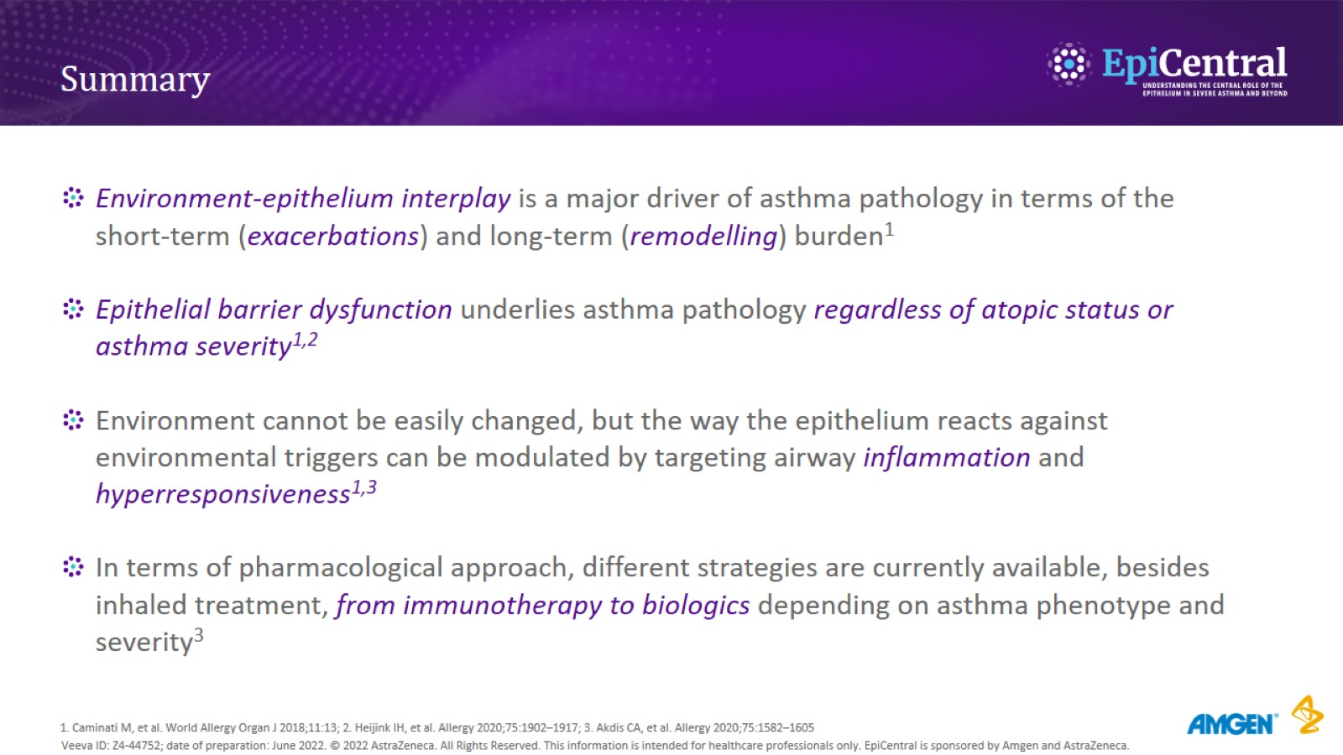
Summary
CN-142722; date of preparation: Dec 2024. © 2025 AstraZeneca. All Rights Reserved. This information is intended for healthcare professionals only. EpiCentral is sponsored and developed by Amgen and AstraZeneca.

Slide 14

Many thanks for your attention
CN-142722; date of preparation: Dec 2024. © 2025 AstraZeneca. All Rights Reserved. This information is intended for healthcare professionals only. EpiCentral is sponsored and developed by Amgen and AstraZeneca.

